Slide 1
Geometric primitives and transformations

Slide 2
Objectives
Study the basic geometric primitive: points, lines, and planes
2D, 3D geometric
The geometric transformations
Lens distortions

Slide 3
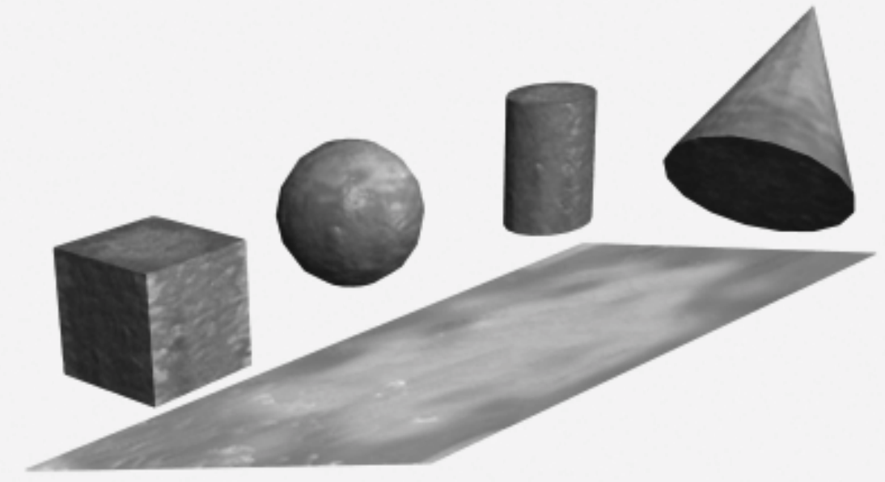
What is a geometric primitive?
Geometric primitives are the basic shapes we all know and recognize
Cubes, spheres, cylinders, and cones,
They work just like the blocks in a typical preschool building set

Slide 4
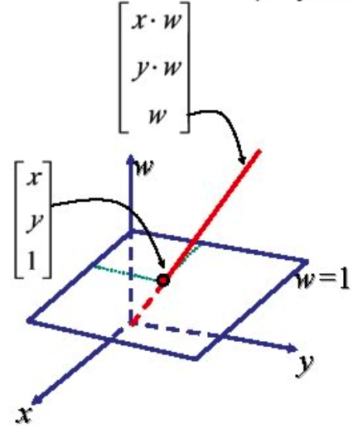
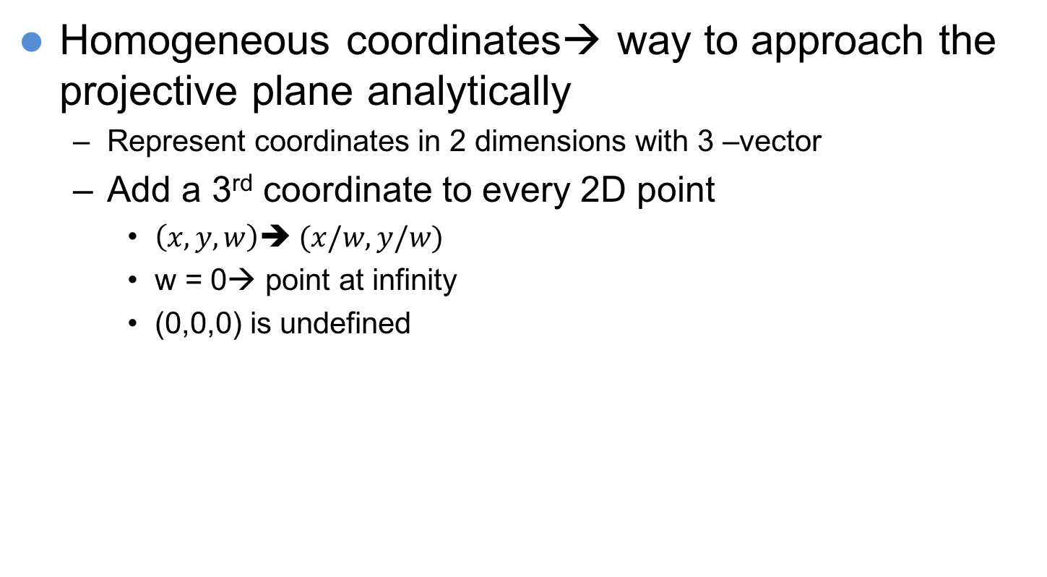
Geometric primitive
Homogeneous coordinates→ way to approach the projective plane analytically
Represent coordinates in 2 dimensions with 3 –vector
Add a 3rd coordinate to every 2D point
$\left(x,y,w\right)➔ (x/w, y/w)$
w = 0→ point at infinity
(0,0,0) is undefined

Slide 5
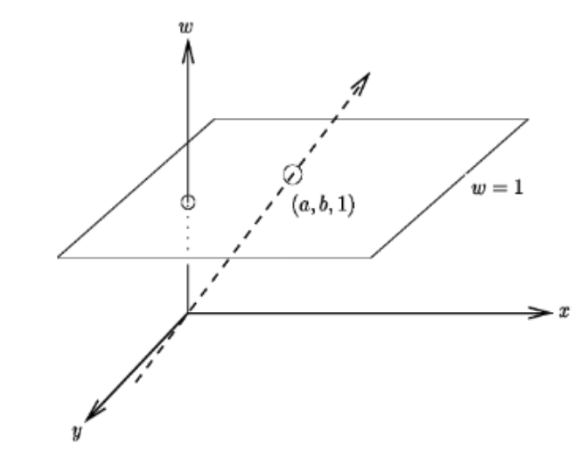

Geometric primitive
2D Point: two-dimensional primitive we can implement. It is infinitely small; it has x and y coordinates: $x=\left(x,y\right)∈ℛ^{2}$
Homogeneous coordinates: $\tilde{x}=\left(\tilde{x},\tilde{y},\tilde{w}\right)∈𝒫^{2}$
The 2D projective space:${ 𝒫}^{2}=ℛ^{3}−(0,0,0)$

Slide 6
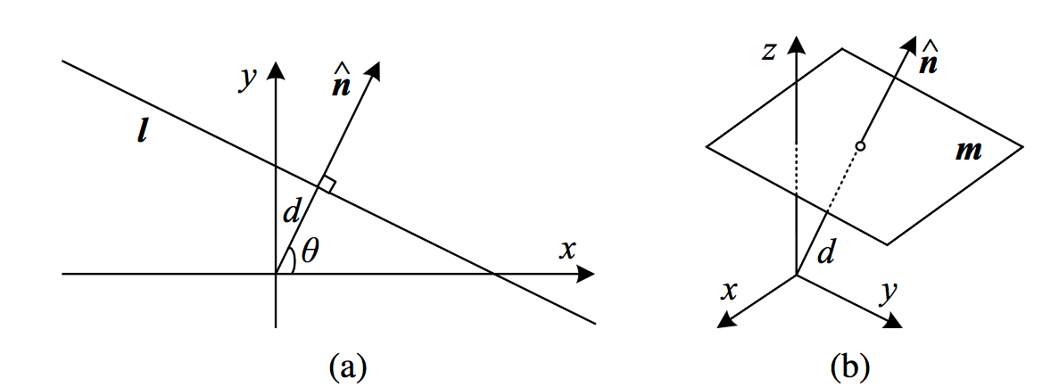

Geometric primitive
2D Lines: A line is a straight one-dimensional figure having no thickness and extending infinitely in both directions
Equation: $ax+by+c=0$
Notes:
(a) 2D line equation and (b) 3D plane equation

Slide 7
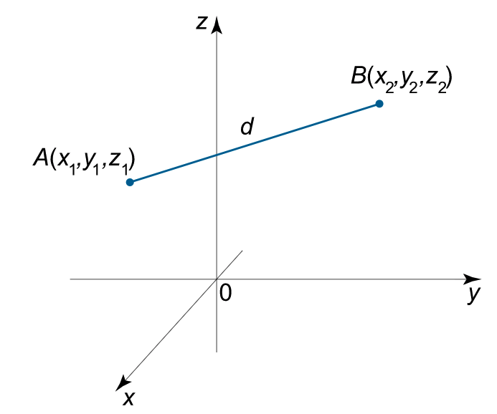
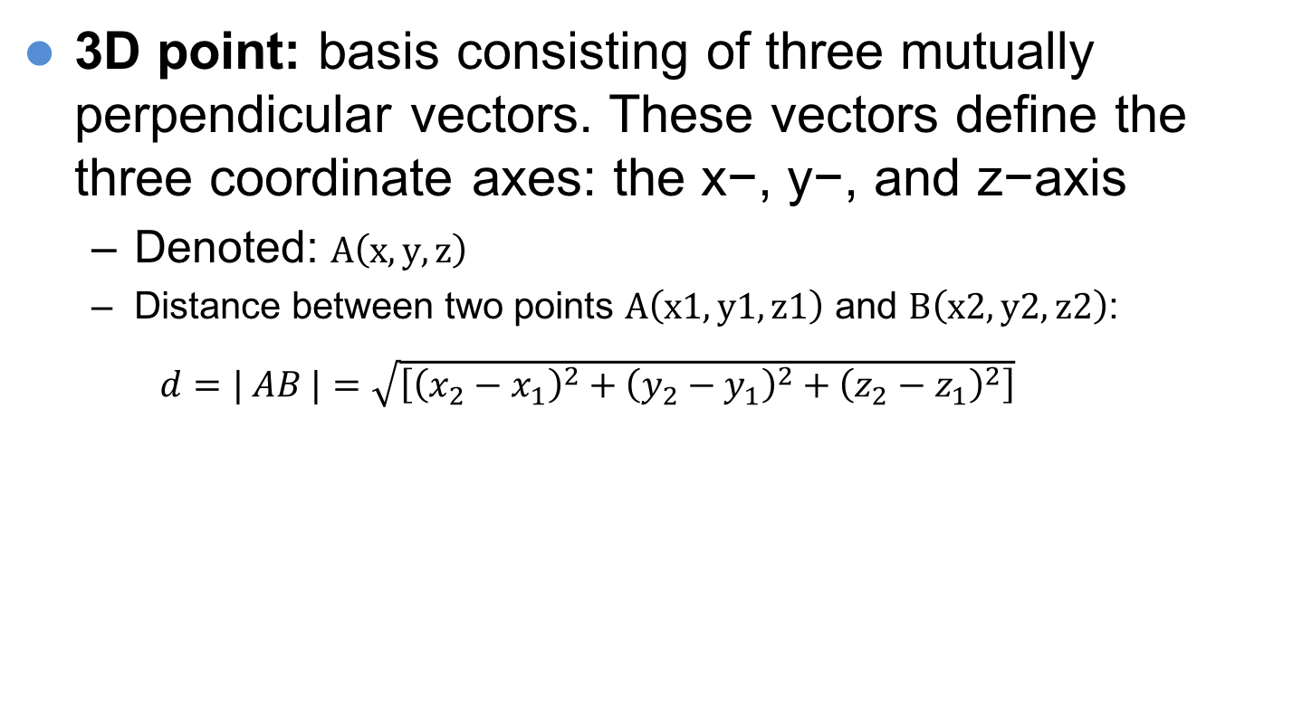
Geometric primitive
3D point: basis consisting of three mutually perpendicular vectors. These vectors define the three coordinate axes: the x−, y−, and z−axis
Denoted: $A\left(x,y,z\right)$
Distance between two points $A\left(x1,y1,z1\right)$ and $B\left(x2,y2,z2\right)$:
$d=| AB |={\sqrt{\left[{\left(x_{2}−x_{1}\right)}^{2}+{\left(y_{2}−y_{1}\right)}^{2}+{\left(z_{2}−z_{1}\right)}^{2}\right]}}^{}$

Slide 8
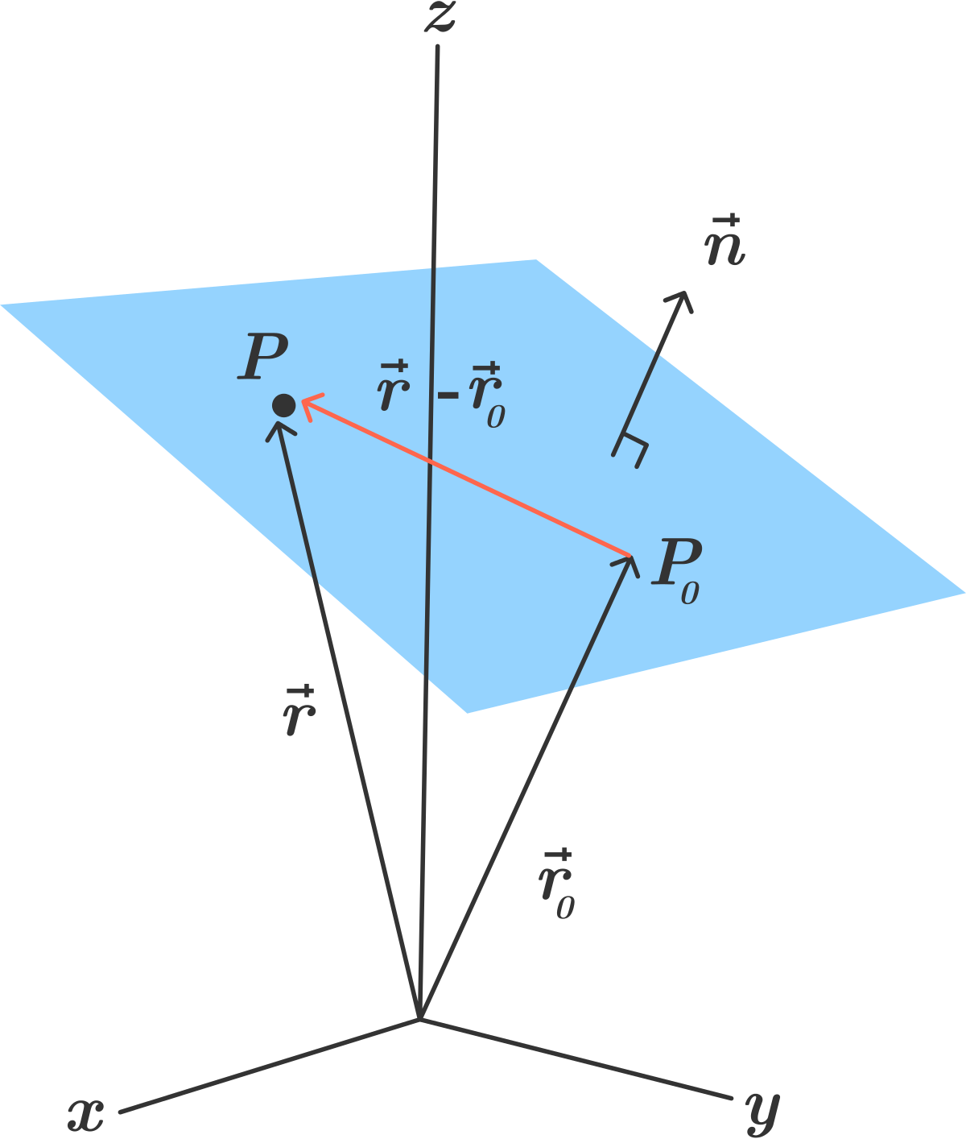
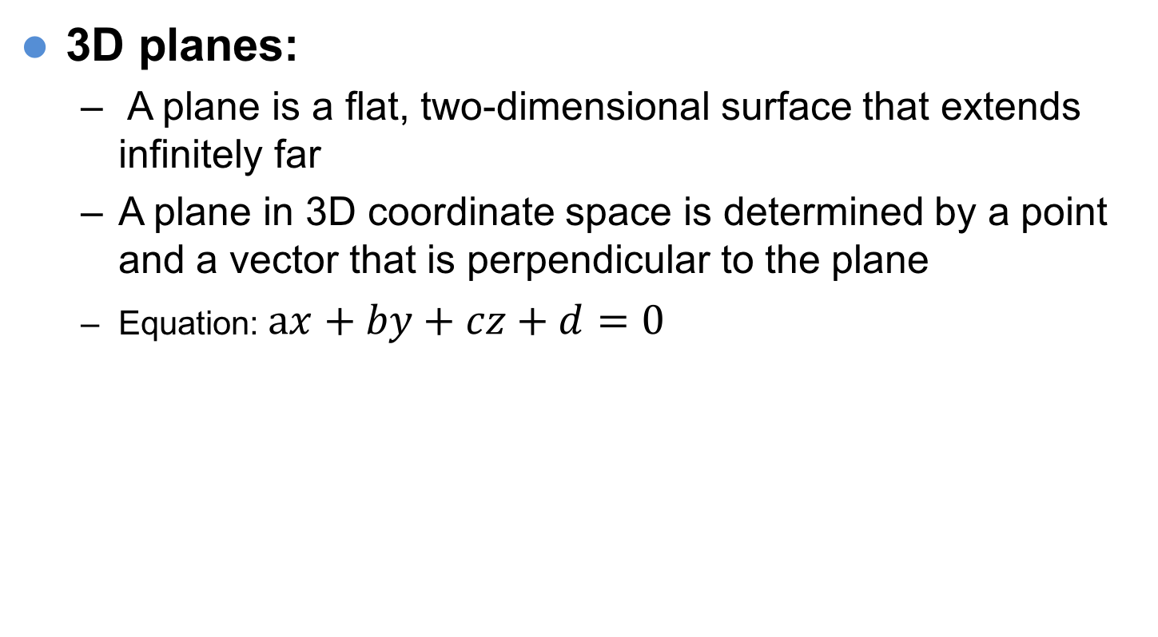
Geometric primitive
3D planes:
A plane is a flat, two-dimensional surface that extends infinitely far
A plane in 3D coordinate space is determined by a point and a vector that is perpendicular to the plane
Equation: $ax+by+cz+d=0$

Slide 9
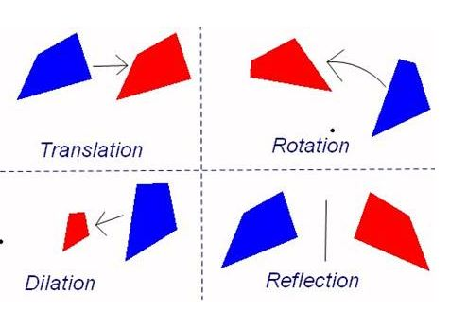

Transformations
Graph transformation is the process by which an existing graph, or graphed equation, is modified to produce a variation of the proceeding graph.
Image transformation is a function or operator that takes an image as its input and produces an image as its output.
Geometric transformation it means changing the geometry of an image. A set of image transformations where the geometry of image is changed without altering its actual pixel values are commonly referred to as “Geometric” transformation.
$$\acute{I}=F(I)$$

Slide 10
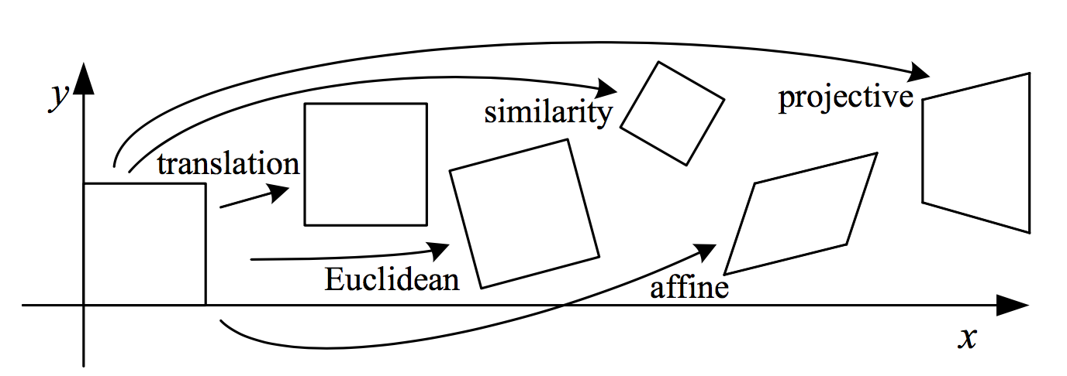
2D Transformations
Basic set of 2D planar transformations.
Translation
Euclidean
Similarity
Affine
Projective

Slide 11
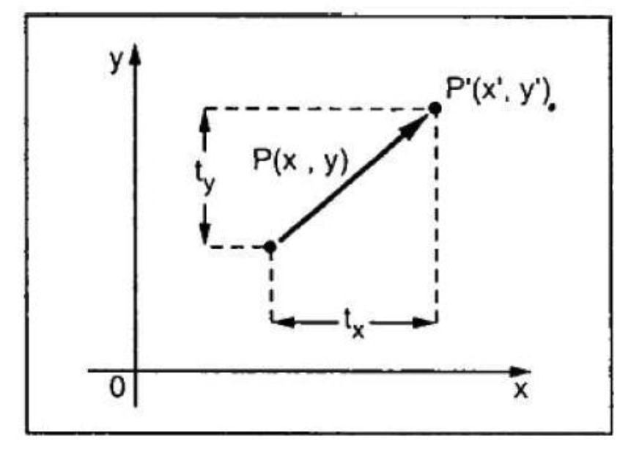
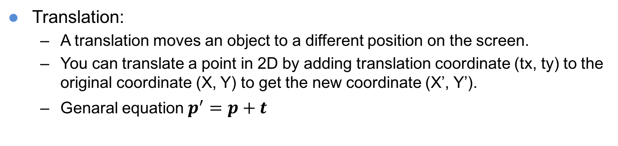
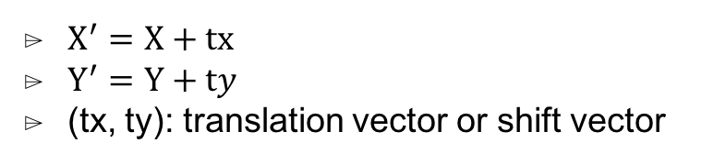
2D Transformations
Translation:
A translation moves an object to a different position on the screen.
You can translate a point in 2D by adding translation coordinate (tx, ty) to the original coordinate (X, Y) to get the new coordinate (X’, Y’).
Genaral equation $p^{′}=p+t$
$X^{′}=X+tx$
$Y^{′}=Y+ty$
(tx, ty): translation vector or shift vector
Notes:
Basic set of 2D planar transformations

Slide 12
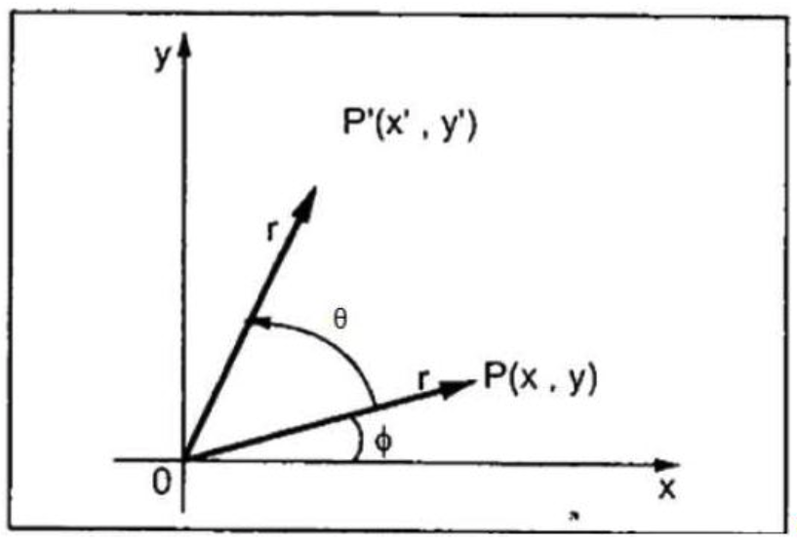

2D Transformations
Rotation:
We rotate the object at particular angle θ (theta) from its origin..
You can translate a point in 2D by adding translation coordinate (tx, ty) to the original coordinate (X, Y) to get the new coordinate (X’, Y’).
Genaral equation: $p^{′}=θp+t$
Notes:
Basic set of 2D planar transformations

Slide 13
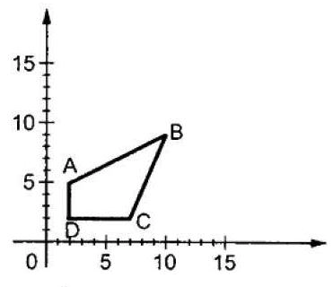
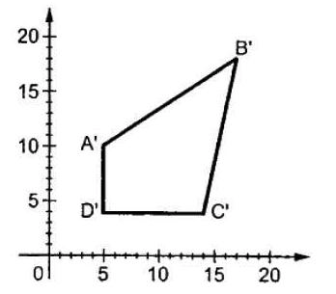
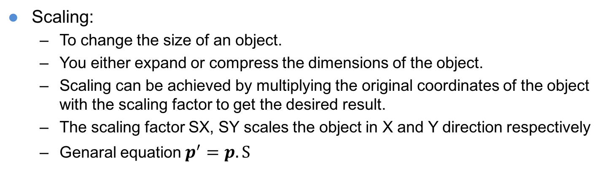
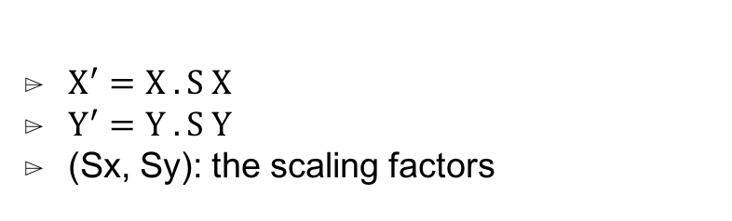
2D Transformations
Scaling:
To change the size of an object.
You either expand or compress the dimensions of the object.
Scaling can be achieved by multiplying the original coordinates of the object with the scaling factor to get the desired result.
The scaling factor SX, SY scales the object in X and Y direction respectively
Genaral equation $p^{′}=p.S$
$X^{′}=X . S X$
$Y^{′}=Y .S Y$
(Sx, Sy): the scaling factors
Notes:
Basic set of 2D planar transformations

Slide 14
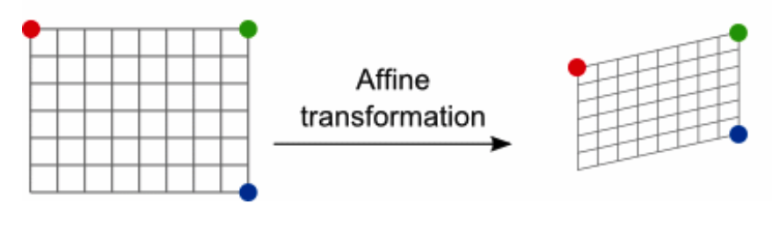
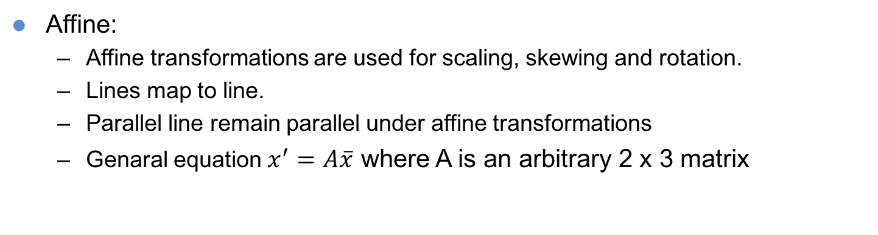
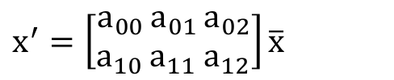
2D Transformations
Affine:
Affine transformations are used for scaling, skewing and rotation.
Lines map to line.
Parallel line remain parallel under affine transformations
Genaral equation $x^{′}=A\overline{x}$ where A is an arbitrary 2 x 3 matrix
$x^{′}=\left[\begin{aligned}a_{00 } \\ a_{10} \end{aligned}\begin{aligned}a_{01 } \\ a_{11} \end{aligned}\begin{aligned}a_{02} \\ a_{12}\end{aligned}\right]{\overline{x}}^{}$
Notes:
If we provide values less than 1 to the scaling factor S, then we can reduce the size of the object. If we provide values greater than 1, then we can increase the size of the object.

Slide 15

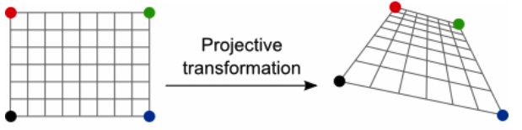

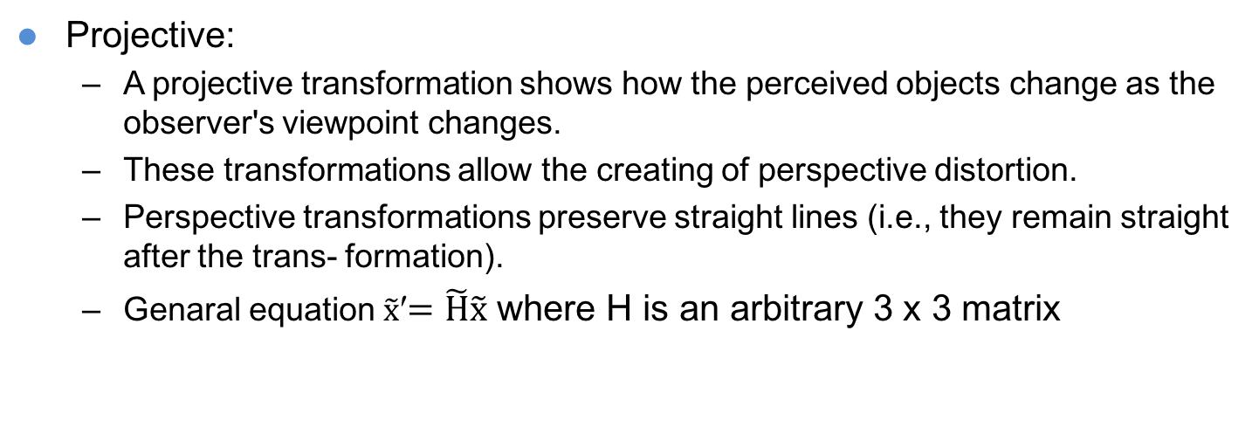
2D Transformations
Projective:
A projective transformation shows how the perceived objects change as the observer's viewpoint changes.
These transformations allow the creating of perspective distortion.
Perspective transformations preserve straight lines (i.e., they remain straight after the trans- formation).
Genaral equation $\tilde{x}$′$=\tilde{H}\tilde{x}$ where H is an arbitrary 3 x 3 matrix
Notes:
If we provide values less than 1 to the scaling factor S, then we can reduce the size of the object. If we provide values greater than 1, then we can increase the size of the object.

Slide 16
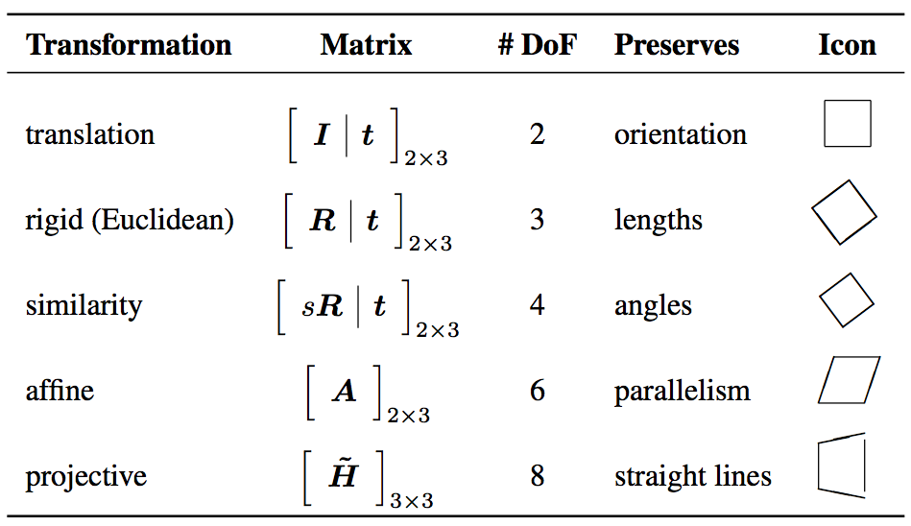
2D Transformations
Notes:
similarity preserves not only angles but also parallelismandstraightlines.The2×3matricesareextendedwithathird[0T 1]rowtoform a full 3 × 3 matrix for homogeneous coordinate transformations.

Slide 17
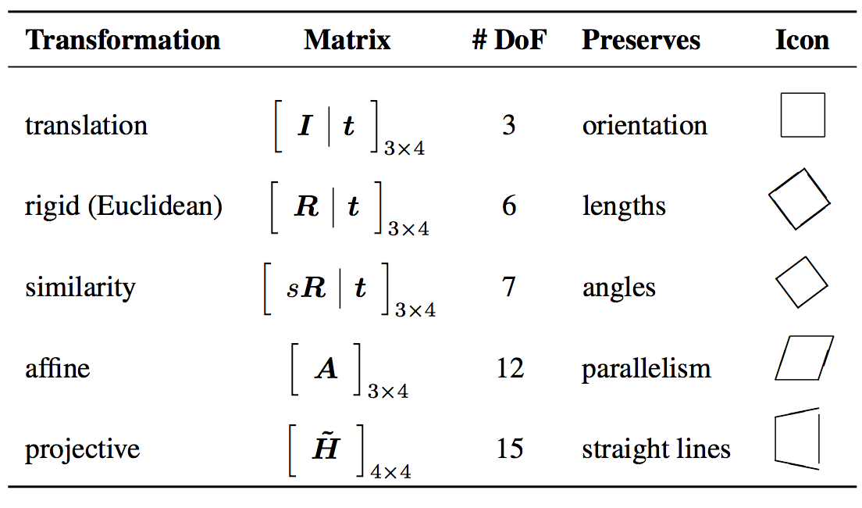
3D Transformations
What are different to 2D transformations?→ write your answer !
Notes:
Each transformation also preserves the properties listed in the rows below it, i.e., similarity preserves not only angles but also parallelism and straight lines. The 3 × 4 matrices are extended with a fourth [0T 1] row to form a full 4 × 4 matrix for homogeneous coordinate transformations. The mnemonic icons are drawn in 2D but are meant to suggest transformations occurring in a full 3D cube.
I is the (3 × 3) identity matrix and 0 is the zero vector.
R is a 3 × 3 orthonormal rotation matrix with RRT = I and |R| = 1.
where s is an arbitrary scale factor.
A is an arbitrary 3 × 4 matrix
H ̃ is an arbitrary 4 × 4 homogeneous matrix

Slide 18
3D to 2D projections
What is projections ?
How 3D primitives are projected onto the image 3D plane?
Linear 3D to 2D projection matrix.
Orthography, which requires no division to get the final (inhomogeneous) result.
Perspective since this more accurately models the behavior of real cameras
Commonly used projection models
Orthography
Scaled orthography
Para-perspective
Perspective
Object-centered
Notes:
Now that we know how to represent 2D and 3D geometric primitives and how to transform them spatially.

Slide 19
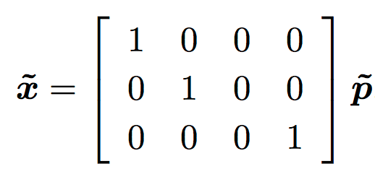
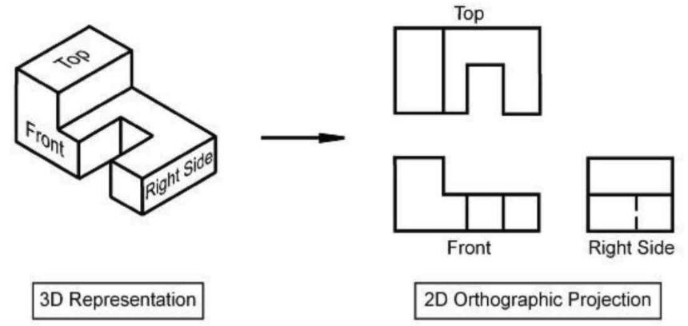

3D to 2D projections
Orthography
Drops the z component of the three-dimensional coordinate p to obtain the 2D point x
Equation : $x=\left[I_{2x2}|0\right]p$ where p denote 3D point and x denote 2D point
In homogeneous coordinates
Notes:
orthographic projection: phép chiếu vuông góc.

Slide 20
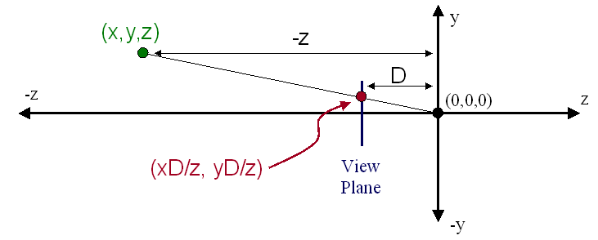
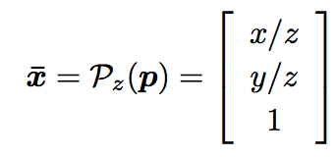
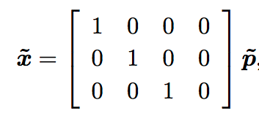
3D to 2D projections
Perspective
When we view scenes in everyday life far away items appear small relative to nearer items.
A side effect of perspective projection is that parallel lines appear to converge on a vanishing point.
Inhomogeneous coordinates
Homogeneous coordinates
Notes:
orthographic projection: phép chiếu vuông góc.

Slide 21
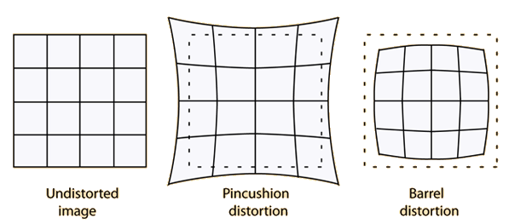
Lens distortions
Cameras obey a linear projection model where straight lines in the world result in straight lines in the image. Is it true in all cases?→ No
Many wide-angle lenses have distortion --> visible curvature in the projection of straight lines.
Distortion occurs when the linear magnification is a function of the off-axis distance.
Notes:
Lens distortions: méo ảnh

Slide 22
Summary
Study the basic geometric primitive: points, lines, and planes
2D, 3D geometric
The geometric transformations
Lens distortions.

